Slide 1

Microsoft Word

Slide 2
Pointer or Cursor
Move your mouse and watch your pointer move around the screen.

Slide 3

Window sizing controls
Move the pointer to the resizing button and click on the left mouse button. What happens? Click on the resizing button again. What happens?

Slide 4
What is Microsoft Word?
Software
A tool
Word processing
Anything you write, you can create with Microsoft Word…anything and more.
Opening a new document is the same as getting out a fresh sheet of paper.

Slide 5
Why Microsoft Word is your friend
Spell Check
Thesaurus
Backspace
Delete
Undo
Redo

Slide 6
Let’s Get Started!

Slide 7
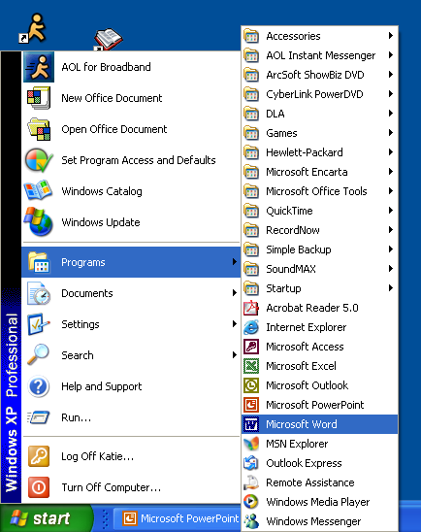
How to Open Microsoft Word
First you select “Start”.
Then you select “Programs”.
Next you select “Microsoft Word”.
This will open the program.

Slide 8
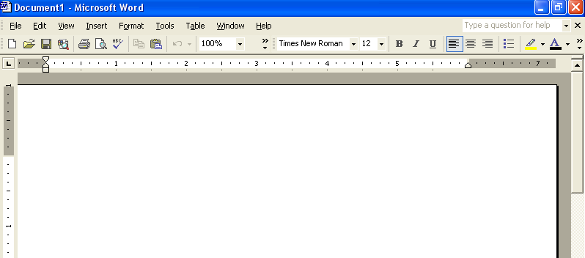
A New Document
When you open Microsoft Word, the screen will originally look like the picture below.

Slide 9
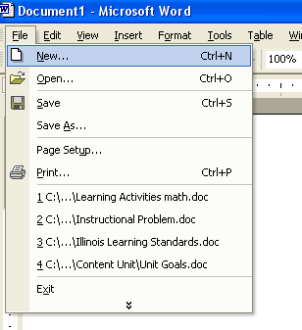
New
This menu choice allows you to open a new document. This document will be blank just like what appeared when you opened the program.

Slide 10
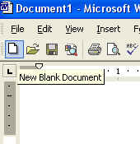
New, continued
Another way to open a new document is to use the icon on the Tool Bar .
The New icon looks like a blank piece of paper.

Slide 11
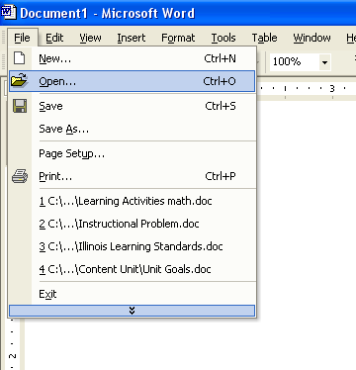
Open
This menu choice allows you to open a document that has previously been saved on this computer. You can also use open to access a file saved on a disk or CD.

Slide 12
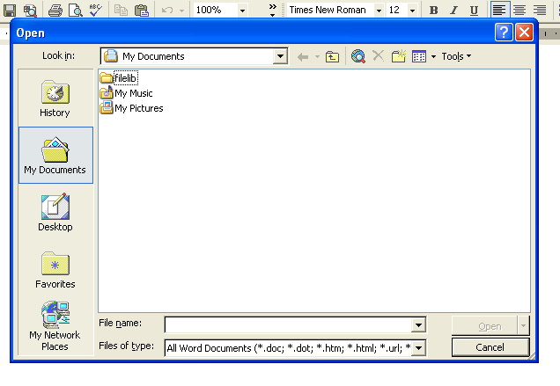
Open, continued
When you choose to open a file, you will have to find where on the computer the file is stored. Typically the computer will look in “My Documents” first. Many people keep all of their documents in the “My Documents” file.

Slide 13
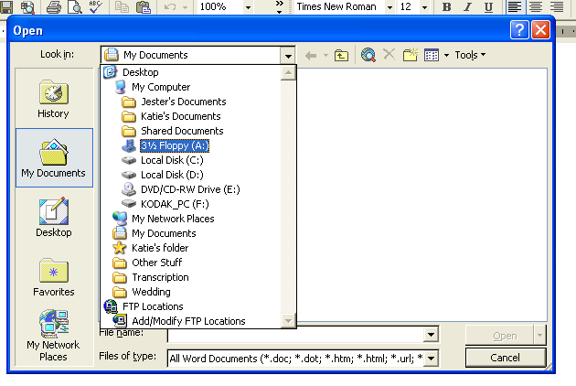
Open, continued
If you want to access a file saved on a disk or CD, you need to use the drop down menu. Find “My Computer” then select the drive your disk or CD is in.

Slide 14
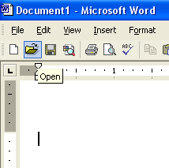
Open, continued
To open an old document from the Tool Bar, click on the icon that looks like a file folder.

Slide 15
There are three toolbars
The Menu Toolbar
The Standard Toolbar
And, The Formatting Toolbar

Slide 16
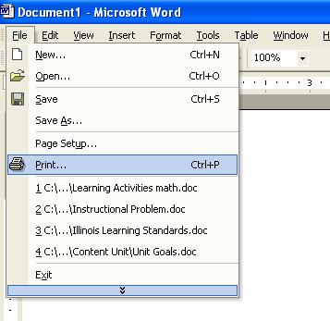
Menu Bar
Menu Bar
Across the top of the screen is the Menu Bar. Here is where you can find many of the features you will need.
The first Menu option is File. There are many important functions in the File menu.
File Menu

Slide 17
The Menu Toolbar

Slide 18
File
  New
  Open
  Save
  Save as…
  Page Setup
  Print Preview
  Print…

Slide 19
Edit
  Undo Typing
  Redo Typing
  Cut
  Copy
  Paste
  Select All
  Find

Slide 20
View
  Normal
  Print Layout
  Toolbars
  Ruler

Slide 21
Insert
  Break
  Page Numbers
  Symbol
  Picture
  Diagram

Slide 22
Format
  Font
  Paragraph
  Bullets and Numbering
  Columns
  Change Case

Slide 23
Tools
  Spelling and Grammar
  Language
  Letters and Mailings

Slide 24
Table
  Draw Table
  Insert
  Delete
  Select
  Table Auto Format
  Show Gridlines

Slide 25
Window
  New Window
  Split

Slide 26
Help

Slide 27
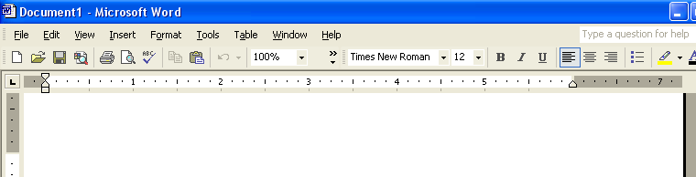
Tool Bar
This is the area below the Menu Bar.
This has a variety of icons (or small pictures).
These icons do many of the same things that you can do from the Menu Bar.
Tool Bar

Slide 28
Toolbars: The Standard Toolbar

Slide 29
What do these icons mean?
PRINT PREVIEW
PASTE
INSERT EXCEL
NEW
SPELL CHECK
UNDO
COLUMNS
OPEN
REDO
HELP
SAVE
CUT
PRINT
COPY
INSERT TABLE

Slide 30
Toolbars: The Formatting Toolbar

Slide 31
Formatting Toolbar and Icons
FONT
FONT SIZE
ALIGN LEFT
NUMBERING
BOLD
BULLETS
ALIGN CENTER
ITALIC
OUTSIDE BORDER
UNDERLINE
ALIGN RIGHT
LINE SPACING
HIGHLIGHTING
FONT COLOR

Slide 32
Ruler
The ruler shows us the size of our document and the placement of our words or pictures.

Slide 33
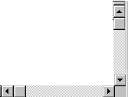
Horizontal/Vertical Scroll bars
Using your left mouse button click and hold the scroll bar. Try the vertical button and the horizontal button. Show your partner what happens.

Slide 34
Status Bar
Current page number
Total number of pages
The status bar is found on the bottom of your screen. It gives you valuable information about the document you are working on.

Slide 35

Insertion Point (flashing)
The flashing insertion point shows were letters will be inserted when you start typing. Find the insertion point on your blank document and show your partner.

Slide 36
Demo: Right Clicking Menu

Slide 37
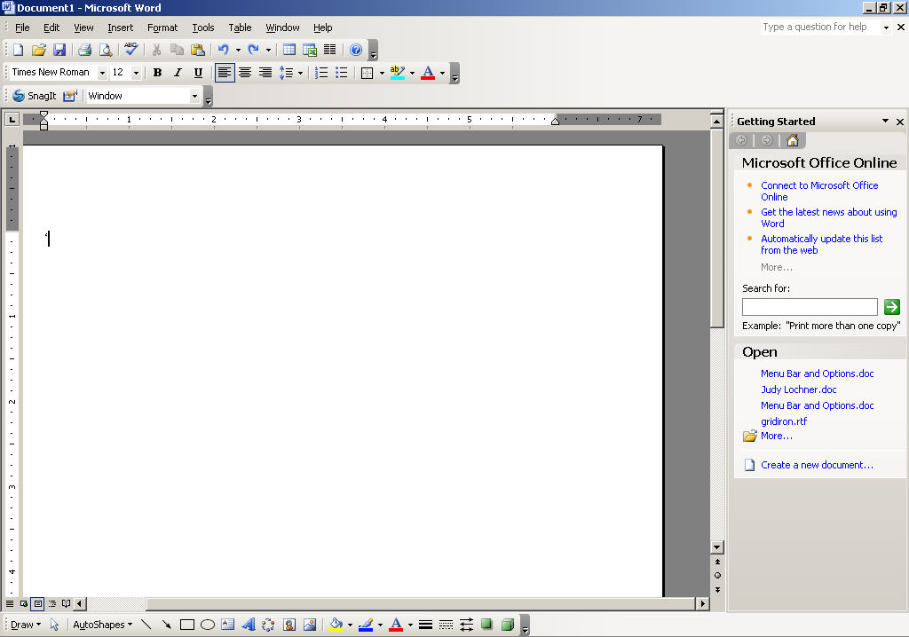
This is what a Microsoft Word window looks like.

Slide 38
Creating and editing a document

Slide 39
Editing a Document
You will learn to use basic formatting to:
Select a font and font size
Add, delete, and move text around
Make text bold or italic
Change line spacing
Indent paragraphs
Create bulleted or numbered lists

Slide 40

Select a font and font size
From the Formatting Toolbar
Using the drop-down device:
  Place cursor on this triangle
  Slide the cursor up and down the types of fonts available
  To select font, click on the font name

Slide 41
Select font size
  To select a font size, do the same maneuver from the Formatting Toolbar, this time using the triangle to the right of the number

Slide 42
Add, delete, and move text around
From the Menu Toolbar
Edit Cut
Edit Copy
Edit Paste
2. From the Standard Toolbar
CUT
COPY
PASTE

Slide 43
Make text bold, italic or underlined
From the Formatting Toolbar
BOLD
ITALIC
UNDERLINED

Slide 44
Change case
From the Menu Toolbar
Format Change Case:
Sentence case.
lowercase
UPPERCASE
Title Case
tOGGLE cASE

Slide 45

Highlighting Text
Acts just like a pen highlighter
The default color for highlighted text is yellow, but you can customize this

Slide 46
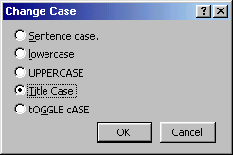
Changing Case
From the Format menu, select Change Case
Notes:
6

Slide 47
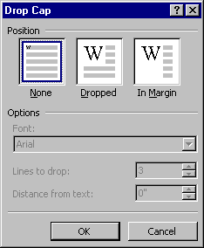

Drop Caps
Allows you to draw attention to the start of a paragraph
Notes:
7

Slide 48
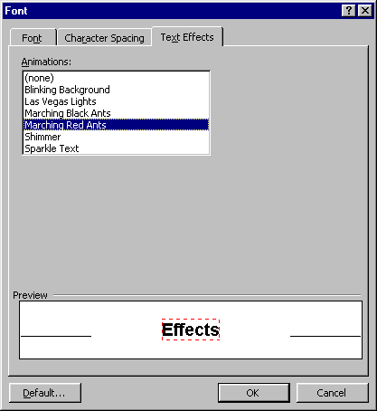
Text Effects
The text effects include:
  None
  Blinking Background
  Las Vegas Lights
  Marching Black Ants
  Marching Red Ants
  Shimmer
  Sparkle Text
The effects DO NOT PRINT!

Slide 49
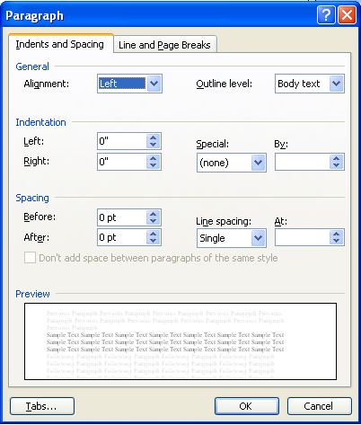
Change line spacing
From the Menu Toolbar
Format Paragraph
From the Formatting Toolbar
LINE SPACING

Slide 50
Indent Paragraphs
From the Menu Toolbar
Format Paragraph

Slide 51
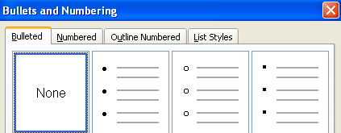
Create bulleted or numbered lists
From the Menu Toolbar
  Format Bullets and Numbering…
From the Formatting Menu
BULLETS
NUMBERING

Slide 52
Font Formatting - Keyboard Shortcuts
All Caps CTRL+SHIFT+A
Bold CTRL+B
Change Case SHIFT+F3
Decrease Point Size CTRL+[
Double Underline CTRL+SHIFT+D
Font CTRL+SHIFT+F
Hidden Text CTRL+SHIFT+H
Increase Point Size CTRL+]
Italic CTRL+I
Revert to Default Font CTRL+SHIFT+Z
Small Caps CTRL+SHIFT+K
Subscript CTRL+=
Superscript CTRL+SHIFT+=
Underline CTRL+U
Word Underline CTRL+SHIFT+W
Notes:
8

Slide 53
Paragraph Formatting Shortcuts
  1.5 Spacing CTRL+5
  Centred CTRL+E
  Double Spacing CTRL+2
  Hanging Indent CTRL+T
  Indent from Left CTRL+M
  Justified CTRL+J
  Left-Aligned CTRL+L
  Normal Style CTRL+SHIFT+N
  Remove Formatting CTRL+Q
  Right-Aligned CTRL+R
  Single Spacing CTRL+1
  Style CTRL+SHIFT+S
Notes:
3

Slide 54
Writing Letters and Résumés

Slide 55
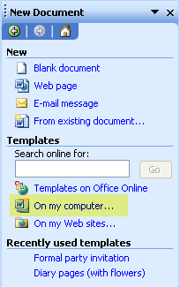
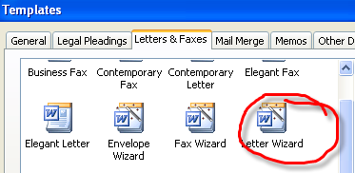
Writing Letters and Resumes
From the Menu bar: File New
On my Computer: Letters

Slide 56
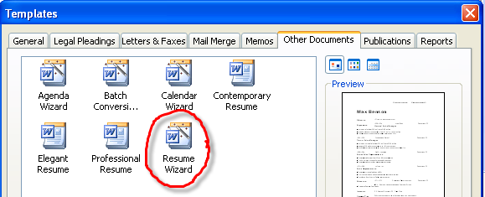
Writing Letters and Resumes
From the Menu bar: File New
On my Computer: Resumes

Slide 57
Saving and Printing a Document

Slide 58
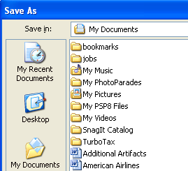
Saving a document
From the Menu Toolbar
  File Save, or
  File Save as…

Slide 59
Saving a document
From the Standard Menu
SAVE
Keyboard shortcuts
Save
  CTRL+S
  SHIFT+F12
Save As
  F12

Slide 60
Printing a document
From the Menu Toolbar
File Page Setup
File Print Preview
File Print
2. From the Standard Menu
PRINT

Slide 61
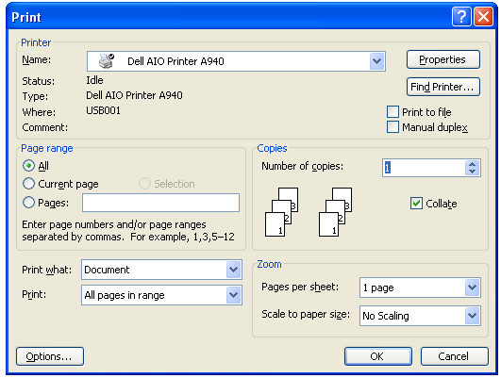

Slide 62


Full Screen View
Displays the document over the entire computer screen
  You are still able to edit and scroll the document
This drop down menu is displayed if you move the mouse pointer to the top of the screen

Slide 63
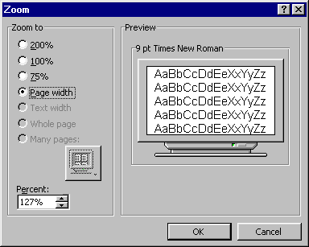
Zoom
Allows you to enlarge or reduce the view of a page on the screen
From the View menu, choose the Zoom command

